Slide 1
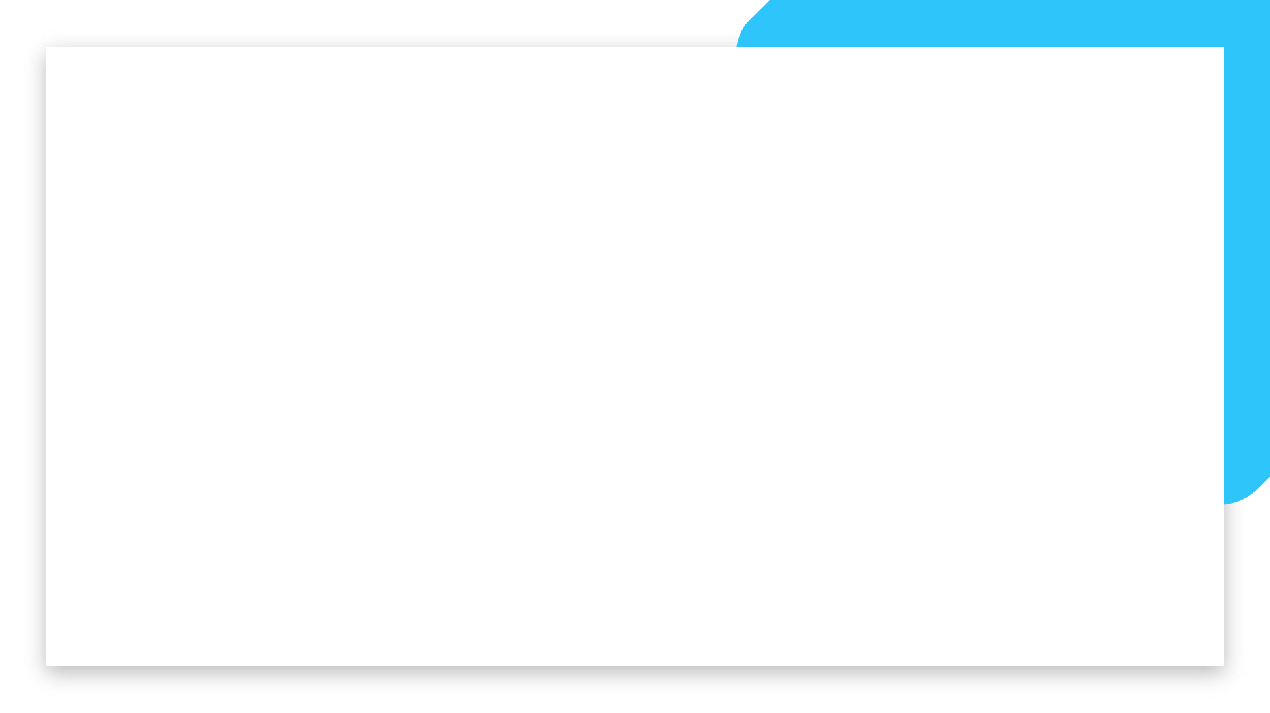
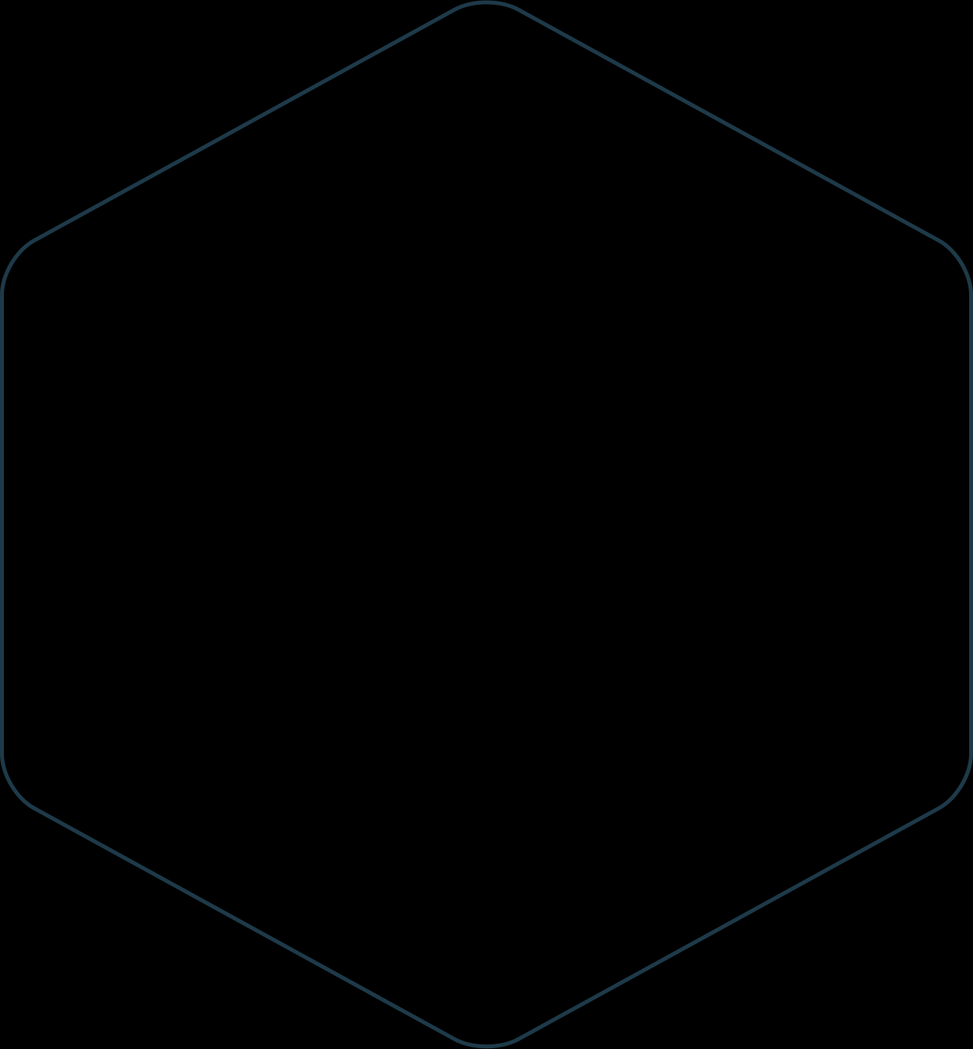
Introduction to Convolutional Neural Networks (CNNs)
Welcome

Slide 2
Why We Need CNNs
To exploit spatial relationships in images for better feature extraction.
To reduce computational complexity and model size.
To automatically learn hierarchical features from low-level edges to high-level shapes.
To achieve high accuracy and efficient training in image-related tasks.
Welcome

Slide 3
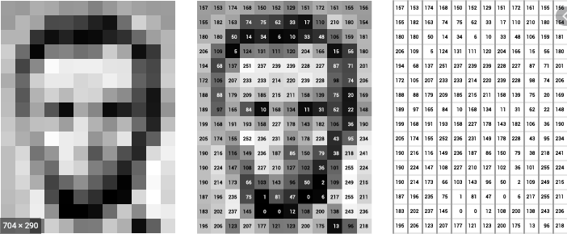
Image as a structure: Greyscale
Welcome

Slide 4
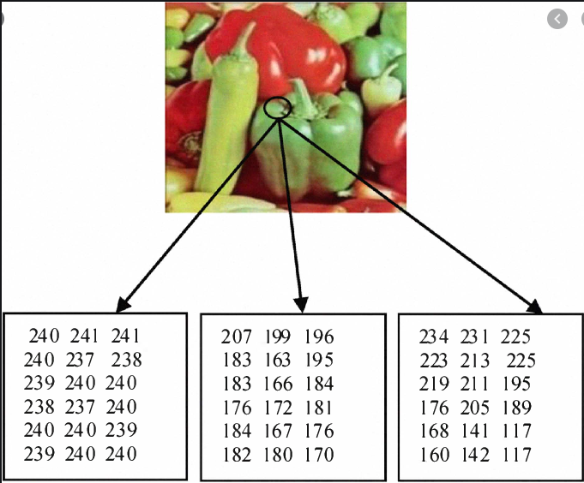
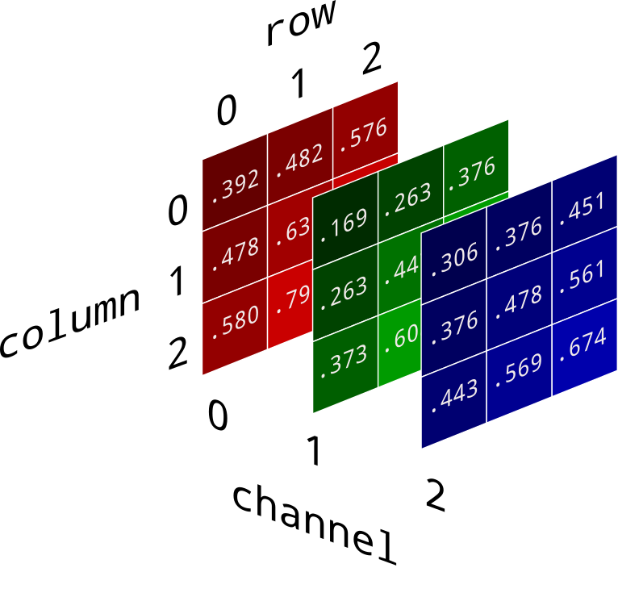
Image as a structure: RGB
R
G
B
Welcome

Slide 5
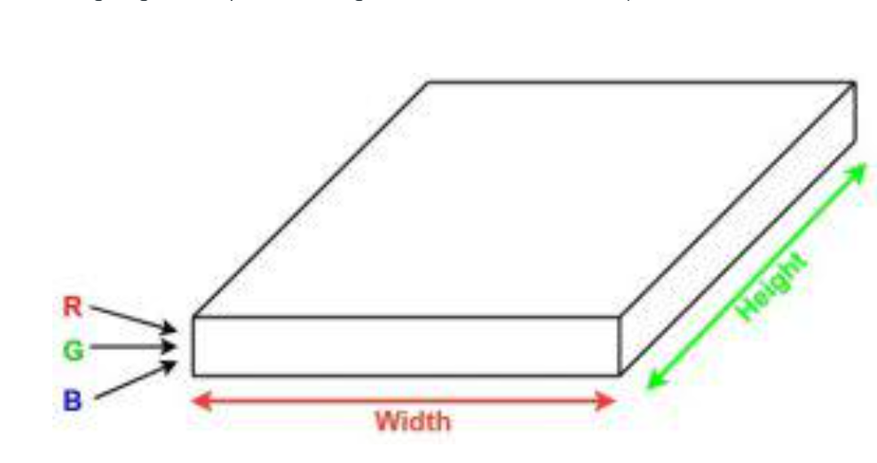

Slide 6
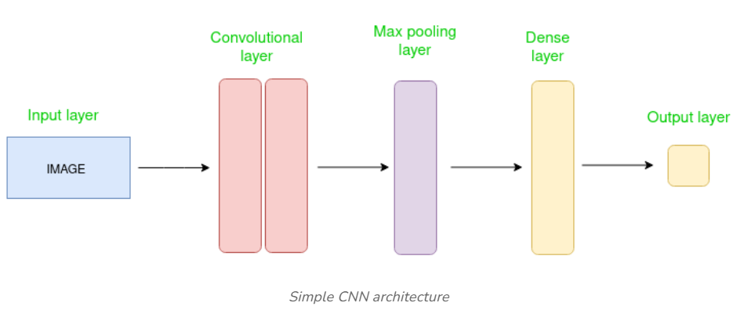
CNNs consist of multiple layers like the input layer, Convolutional layer, pooling layer, and fully connected layers. Let's learn more about CNNs in detail.
Welcome

Slide 7
Let’s take an example by running a covnets on of image of dimension 32 x 32 x 3.
Input Layer: It’s the layer in which we give input to our model. In CNN, Generally, the input will be an image or a sequence of images. This layer holds the raw input of the image with width 32, height 32, and depth 3.
Welcome

Slide 8
Convolutional Layers:
This is the layer, which is used to extract the feature from the input dataset. It applies a set of learnable filters known as the kernels to the input images. The filters/kernels are smaller matrices usually 2x2, 3x3, or 5x5 shape. it slides over the input image data and computes the dot product between kernel weight and the corresponding input image patch. The output of this layer is referred as feature maps. Suppose we use a total of 12 filters for this layer we’ll get an output volume of dimension 32 x 32 x 12.
Welcome

Slide 9
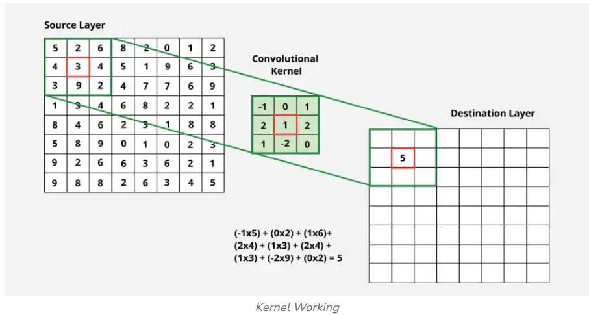
Convolutional Layers:
Welcome

Slide 10
Activation layer:
By adding an activation function to the output of the preceding layer, activation layers add nonlinearity to the network. it will apply an element-wise activation function to the output of the convolution layer. Some common activation functions are RELU: max(0, x), Tanh, Leaky RELU, etc. The volume remains unchanged hence output volume will have dimensions 32 x 32 x 12.
Welcome

Slide 11
Pooling layer:
This layer is periodically inserted in the covnets and its main function is to reduce the size of volume which makes the computation fast reduces memory and also prevents overfitting. Two common types of pooling layers are max pooling and average pooling.
Welcome

Slide 12
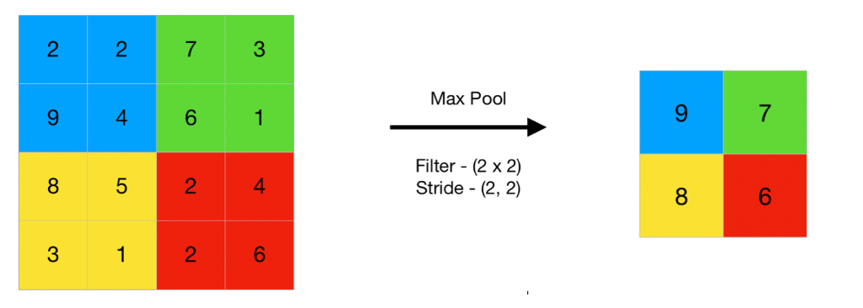
Pooling layer:
Max Pooling
Welcome

Slide 13
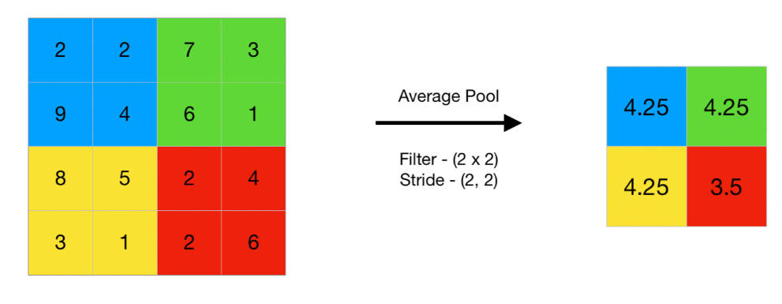
Pooling layer:
Average Pooling
Welcome

Slide 14
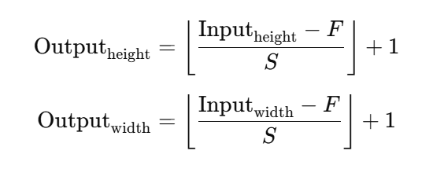
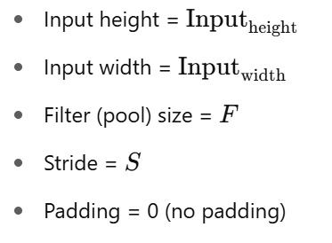
Pooling layer:
Welcome

Slide 15
Flattening: The resulting feature maps are flattened into a one-dimensional vector after the convolution and pooling layers so they can be passed into a completely linked layer for categorization or regression.
Fully Connected Layers: It takes the input from the previous layer and computes the final classification or regression task.
Welcome

Slide 16
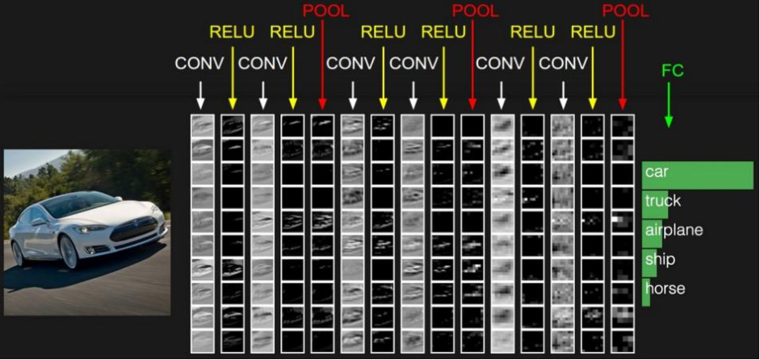
Welcome

